Slide 1
MICRO-CONTROLLER BASED AUTOMATIC POWER MANAGEMENT SYSTEM FOR MULTIPLE ENERGY SOURCES 19EEE381 – Open Lab
Submitted by:
CB.EN.U4EEE22032 PRITHIKA SV
CB.EN.U4EEE22046 SUCHITA SRIVASTAVA
CB.EN.U4EEE22048 TARUN SUBRAMANIAN
CB.EN.U4EEE22056 VISHNUVARTHAN L

Slide 2
INTRODUCTION
Energy sustainability and efficiency are critical global concerns.
Increasing reliance on electrical power for industrial, commercial, and residential applications.
Power outages, voltage fluctuations, and maintenance disruptions impact critical sectors like hospitals, industries, and households.
Many regions, especially in developing countries, still use conventional manual power switching systems, which are inefficient and slow.
Automated power management systems ensure a seamless transition between multiple energy sources, improving reliability and efficiency.
A hybrid energy approach optimizes power utilization by integrating multiple energy sources, reducing dependency on any single source.
The proposed microcontroller-based system minimizes energy wastage, prevents load interruptions, and enhances energy security.

Slide 3
PROBLEM STATEMENT
Reliable and efficient power management is crucial for sustainable energy systems. However, frequent power outages, voltage fluctuations, and reliance on manual switching mechanisms continue to disrupt critical sectors such as healthcare, industries, and residential areas, particularly in regions with inadequate energy infrastructure.
This project proposes a Microcontroller-Based Automatic Power Management System that intelligently integrates multiple energy sources, including solar power, DC regulated power supply (DCRPS), and battery storage. Unlike conventional single-source systems, this hybrid approach ensures seamless energy transitions, minimizes wastage, and enhances reliability.
By leveraging a microcontroller-based decision-making system, the proposed solution dynamically optimizes power distribution, preventing load interruptions and improving energy security. This innovation supports smart grids, renewable energy integration, and standalone power management, making it a scalable and sustainable solution for modern energy challenges.

Slide 4
METHODOLOGY
Identify power sources (solar panels, DCRPS, and battery storage) for integration.
Select an Arduino microcontroller as the central processing unit for automated control.
Design the system architecture, including power inputs, control circuits, and output load.
Connect voltage sensors to monitor the status and availability of each power source.
Develop a priority-based algorithm to ensure efficient source selection.
Program the Arduino in Embedded C to process sensor data and automate switching.
Use electromechanical relays to enable smooth power source transitions.
Design and integrate a relay driver circuit to handle switching operations.
Implement a real-time monitoring system with an LCD display for source status updates.
Ensure seamless switching by testing relay response time and stability.
Simulate power failures to validate automatic source transitions.
Measure energy efficiency under different load conditions to optimize performance.
Analyze system response time to minimize delays in power switching.
Optimize microcontroller programming for reliability and low power consumption.
Finalize hardware and software integration for real-world deployment and scalability.

Slide 5
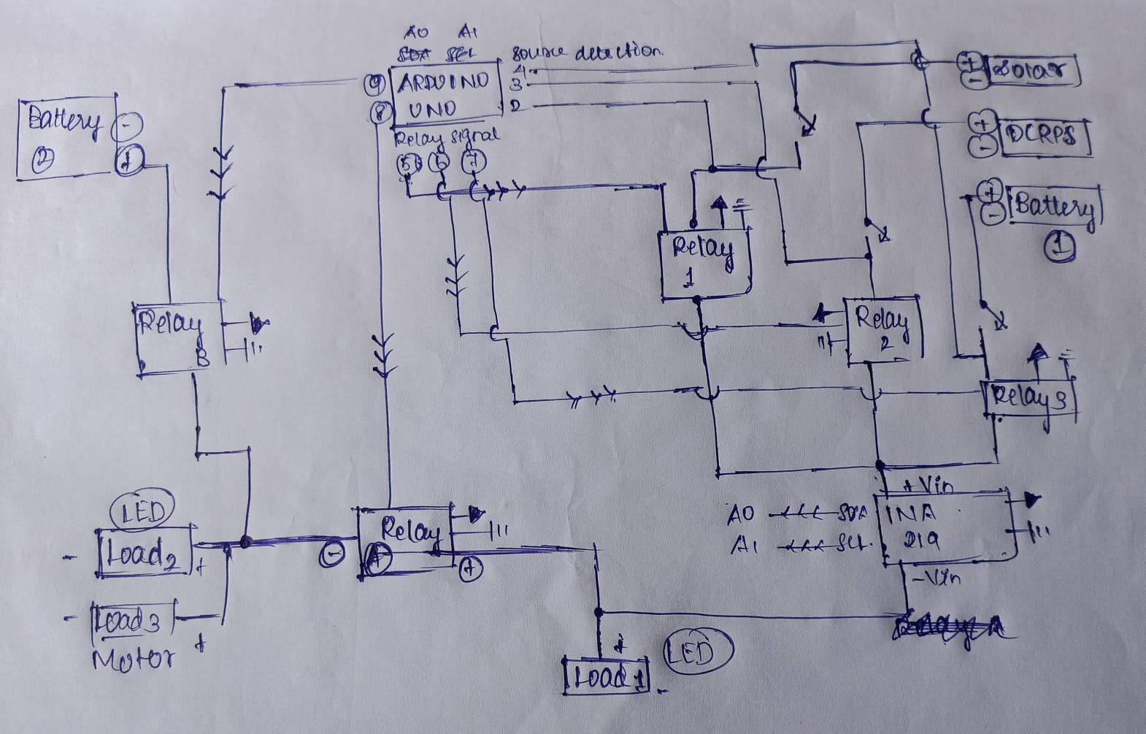
CIRCUIT DIAGRAM

Slide 6
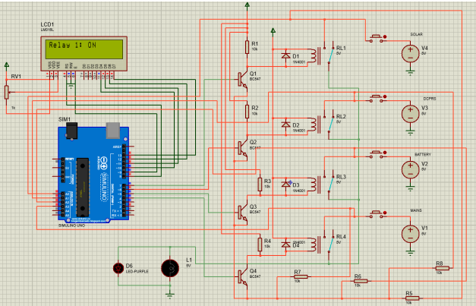
SIMULATION RESULT

Slide 7
CONCLUSION
The automated power management system ensures a reliable and uninterrupted power supply by eliminating manual switching inefficiencies.
A microcontroller-based decision-making process dynamically selects the best energy source (solar, DCRPS, or battery storage).
Experimental results confirm seamless power transitions, improved stability, and energy efficiency under varying conditions.
The system reduces energy wastage, minimizes human intervention, and enhances power reliability for various applications.
This solution supports renewable energy integration, off-grid electrification, and smart energy grids, contributing to sustainable energy management.

Slide 8
FUTURE WORK
IoT-Based Remote Monitoring & Control
Integrate IoT technology to enable real-time tracking of power sources and system performance via a mobile app or web dashboard.
Allow users to remotely monitor energy consumption and receive alerts for system faults or power source changes.
Machine Learning for Smart Energy Optimization
Implement AI-driven algorithms to predict energy demand and optimize power source selection.
Enhance efficiency by dynamically adjusting power distribution based on real-time and historical data.
Hybrid Renewable Energy Integration
Expand the system by integrating additional renewable sources like wind or hydro to improve reliability.
Create an adaptive control system that selects the most efficient combination of energy sources based on availability.
Advanced Battery Management System (BMS)
Develop a smarter BMS to extend battery lifespan by preventing overcharging, deep discharging, and optimizing energy storage.

